Slide 1



TECHNOVATE IT SOLUTIONS
CYBERSECURITY
FOR SMES IN AUSTRALIA
PROTECTING YOUR BUSINESS IN THE DIGITAL AGE
www.technovateit.com.au

Slide 2


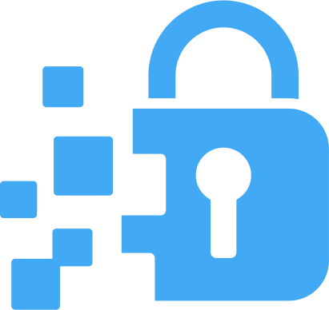

INTRODUCTION
Why Cybersecurity Matters
Cybersecurity is no longer optional — it’s essential.
In today’s connected world, small and medium businesses are on the frontlines of cybercrime. This presentation explores why cybersecurity matters, what threats you face, and how to protect your business with confidence. Effective cybersecurity ensures the confidentiality, integrity, and availability of information, minimizing risks and vulnerabilities.
Protect Data
Enhance Reputation

Slide 3


TECHNOVATE IT
WHY SMES ARE CYBER TARGETS
🔸 43% of all cyberattacks are aimed at small and medium businesses.
🔸 Lack of dedicated IT staff or security infrastructure makes SMEs easier to breach.
🔸 Ransomware groups now target healthcare, aged care, education, and professional services.
Ransomware
Real Cost of an Attack
  $276,000 average cost of a data breach for an SME in Australia
  60% of SMBs shut down within 6 months after a cyberattack
  Recovery time: 3-6 months depending on business disruption
Phishing
Data Breaches
Malware
CYBERCRIMINALS DON’T CARE ABOUT YOUR SIZE. THEY CARE ABOUT YOUR VULNERABILITIES.

Slide 4
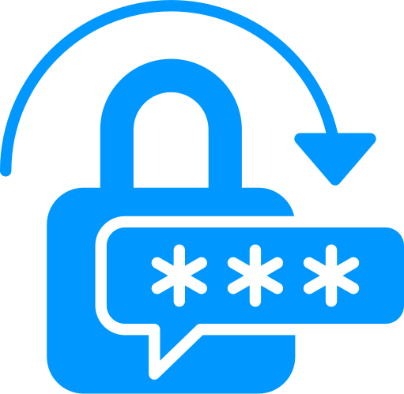




COMMON CYBERSECURITY THREATS FACING SMES
Phishing Attacks
Ransomware
Tricking staff into clicking malicious links or giving away passwords.
Hackers lock your systems and demand payment to unlock them.
Business Email Compromise
Data Breaches
Hackers pose as vendors or managers and trick staff into sending money or data.
Caused by misconfigurations, weak passwords, or old systems.
IT ONLY TAKES ONE CLICK, ONE WEAK PASSWORD, OR ONE OUTDATED SYSTEM TO INVITE DISASTER.

Slide 5




3 PILLARS OF STRONG CYBERSECURITY
PEOPLE
PROCESS
TECHNOLOGY
Your greatest vulnerability or your strongest defence.
Train your staff to spot threats and act fast.
Clear cybersecurity policies, data handling protocols, and incident response plans.
Without a plan, panic rules the breach.
Modern tools like firewalls, encryption, secure cloud environments.
Invest in layered, integrated protections that scale with you.
Invest in layered, integrated protections that scale with you.

Slide 6




CYBERSECURITY TRENDS
AI & MACHINE LEARNING
ZERO TRUST SECURITY
CLOUD SECURITY
BLOCKCHAIN FOR SECURITY
AI isn’t just helping defenders — YES, it’s helping attackers too.
Hackers now use AI to: Write realistic phishing emails | Discover system vulnerabilities faster | Automate brute-force password attacks
What it means for SMEs:
You need smarter defences that evolve with threats. Basic antivirus is no longer enough.

Slide 7
BEST PRACTICES TO STRENGTHEN YOUR SECURITY
Conduct Security Assessments
Backups & Recovery Plans
Quarterly audits identify and fix vulnerabilities.
Staff should only access what they need to do their jobs.
Update Software & Systems
Secure Remote Work
Unpatched systems are open doors for hackers.
Use VPNs, device encryption, and remote access controls.
Two-Factor Authentication
Employee Training
Prevent 99% of password-related breaches.
Cybersecurity isn’t one-time training. It’s ongoing awareness.

Slide 8


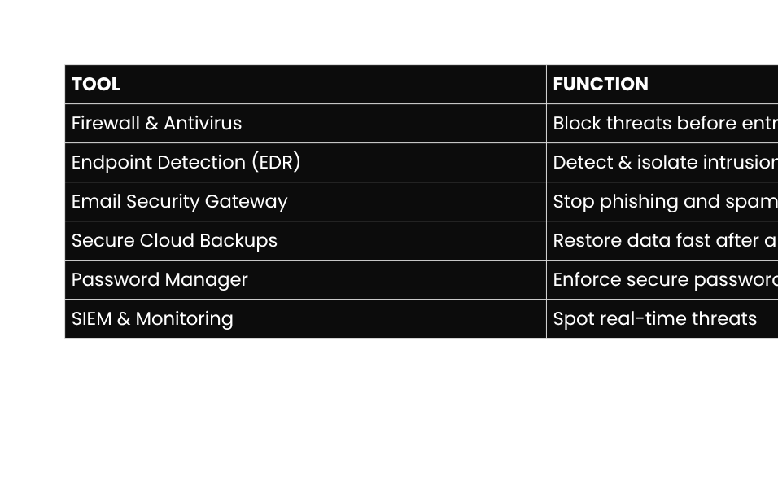
TOOLS TO SAFEGUARD YOUR DIGITAL ASSETS
ANTIVIRUS
FIREWALLS
ENCRYPTION
BACKUP
Several cybersecurity tools and technologies can help secure systems and networks. Firewalls, antivirus software, encryption, and intrusion detection systems are all crucial for preventing unauthorized access and mitigating risks.

Slide 9


TIMMERMAN INDUSTRIES
THE ROLE OF EMPLOYEES IN CYBERSECURITY
Empowering Employees for Stronger Security
Employees play a critical role in maintaining cybersecurity. They must be trained to recognize phishing attempts, follow security policies, and practice safe online behaviors. A security-aware workforce is the first line of defense against cyber threats.

Slide 10
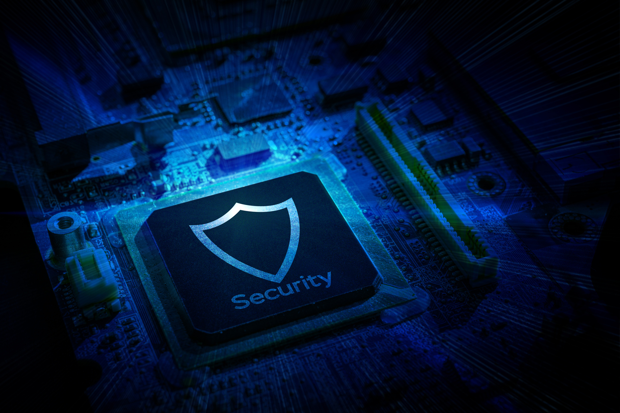

UNDERSTANDING THE AUSTRALIAN LEGAL LANDSCAPE
Ensuring Data Privacy and Compliance
Data Encryption
Encrypt sensitive data to comply with privacy laws.
Australia's Privacy Act 1988 and Notifiable Data Breaches (NDB) Scheme mandate:
  Protection of customer and employee data
  Timely breach notifications if there's risk of serious harm
  Strong governance over personal information
📌 Non-compliance can lead to fines up to $2.1 million
📌 More importantly, it damages trust — the one thing you can't buy back
Privacy Policies
Regularly update company policies to align with regulations

Slide 11

HOW TO START:
01.
Risk Assessment
5-Step Cyber Plan
02.
Security Roadmap
Incident Response Plan
03.
Awareness Training
An effective incident response plan helps organizations react swiftly to cyberattacks and minimize damage. The plan should include identifying threats, isolating infected systems, and notifying stakeholders.
04.
Technology
05.
Continuous Monitoring

Slide 12
TECHNOVATE IT
YOUR CYBERSECURITY PARTNER
We go beyond the basics.
Technovate offers:
✅ Cybersecurity strategy development
✅ End-to-end network protection
✅ Data backup & disaster recovery
✅ Cloud security & compliance consulting
✅ Staff training & awareness sessions
✅ 24/7 monitoring & support
Aged Care & Retirement Living
Education & Schools
Healthcare Practices
Startups & SMEs
WE DON’T JUST PROTECT YOUR BUSINESS — WE HELP IT THRIVE SECURELY.

Slide 13


WANT A SAFER BUSINESS? START HERE.
Let’s look at your setup, spot weaknesses, and build a better defence — together.
Your business deserves more than protection. It deserves peace of mind.
www.technovateit.com.au
hello@technovateit.com.au

